Slide 1
Bare Infinitive, To Infinitive or -ing Form?

Slide 2
-ING Form We use -ing form after following verbs:
Avoid
Admit
Consider
Deny
Enjoy
Fancy
Finish
Forgive
Give up
Go/Carry on
Imagine
Keep/on
Look forward to
Mind
Miss
Postpone
Practise
Prevent
Put off
Risk
Suggest
Understand
Insist on smg/doing

Slide 3
-ING Form
-a noun in the form of a verb (I like shopping.)
-after expressions: don´t mind; can´t stand; be/get used to; it´s (not) worth
-after the verb GO (go skiing, go shopping...)
-when used at the beginning of a sentence (Shopping is my favourite free time activity.)

Slide 4
To Infinitive We use to infinitive after following verbs:
Advise
Afford
Afraid
Agree
Appear
Arrange
Choose
Claim
Dare (also BI)
Decide
Deserve
Expect
Fail
Forget
Help (also BI)
Hope
Learn
Manage
Need
Offer
Plan
Pretend
Promise
Refuse
Remind
Seem
Tend
Threaten
Want
Would like
Would love
Would prefer

Slide 5
To Infinitive
-to express purpose: He came to repair a broken car.
-after some adjectives: glad, happy, sad, lucky... I´m glad to tell you...
-after expressions too/enough: I am too old to get married.

Slide 6
Bare Infinitive
-after MODAL VERBS (can, could, have to, may, might, must, ought to,
shall, should, will, would...)
-after verbs: LET, MAKE, HELP
E.g.: Let us think.
He made them work hard.
My mum helped me become a better person.
-after expressions: I´d rather / I´d better (I would rather watch TV.)

Slide 7
Verbs that can be followed by To Infinitive or –ING form
Hate
Like
Love
Prefer
Begin
Start
Continue
Bother
Intend
Mean
Remember
Regret CHANGE in MEANING
Go on !!!
Stop
Try

Slide 8
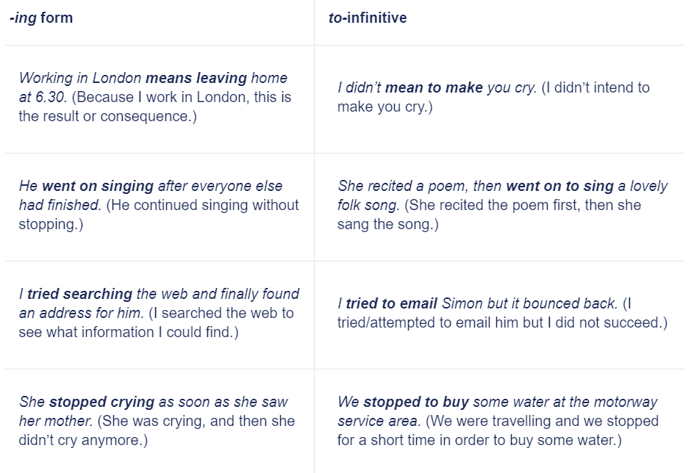
Compare:

